Slide 1
Welcome to
Our Sunday School
We’ll start at 9:07
visit OurSundaySchool.com for more about our class

Slide 2
Today’s class (pages 70-75)
Philippians 1:19b-20

Slide 3
Philippians 1:19b-20 (CSB)
What does it matter? Only that in every way, whether from false motives or true, Christ is proclaimed, and in this I rejoice. Yes, and I will continue to rejoice because I know this will lead to my salvation through your prayers and help from the Spirit of Jesus Christ. My eager expectation and hope is that I will not be ashamed about anything, but that now as always, with all courage, Christ will be highly honored in my body, whether by life or by death.

Slide 4
Today’s class (pages 70-75)
Philippians 1:19b-20

Slide 5
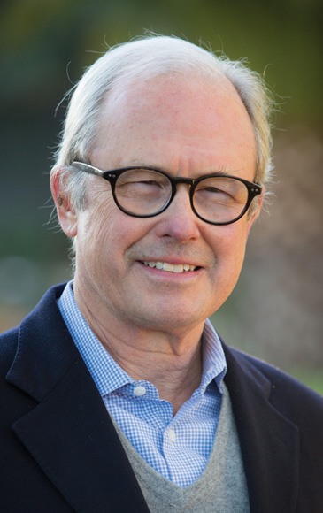
Dr. G. Walter Hansen The deliverance Paul has in mind is accomplished through the combined power of the prayers of his friends and God’s provision of the Spirit of Jesus Christ.

Slide 6
Dr. G. Walter Hansen The way Paul combines prayers and God‘s provision of the Spirit shows how closely human prayers and God‘s provision are related.

Slide 7
Today’s class (pages 70-75)
Philippians 1:19b-20

Slide 8
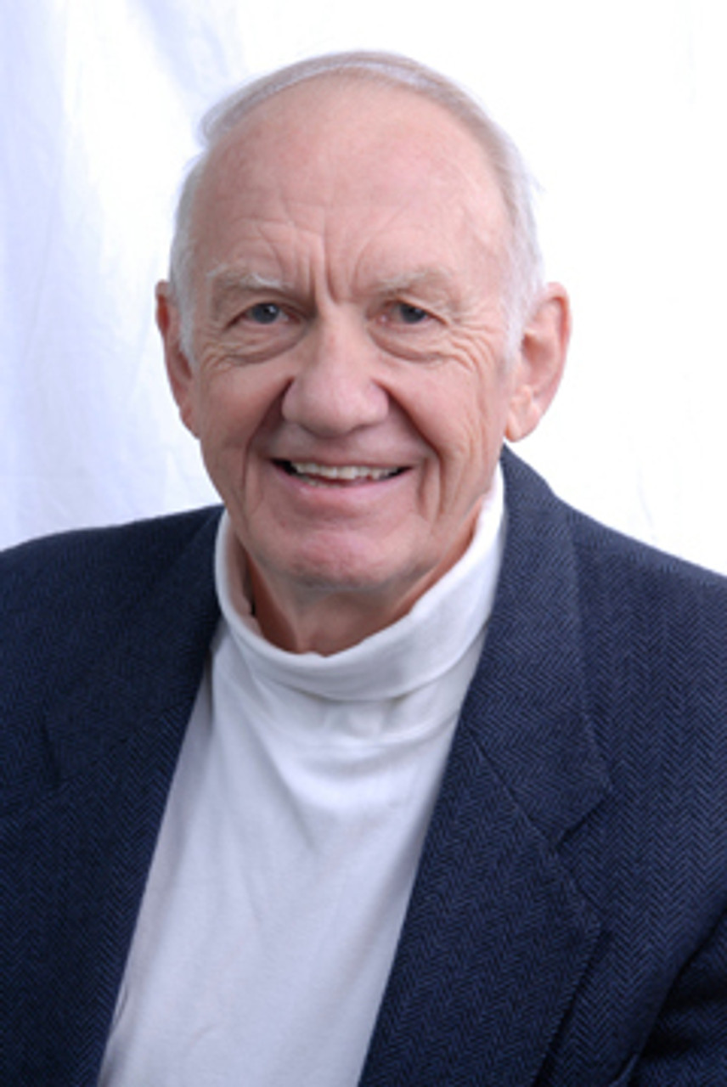
Dr. Gordon Fee He simply does not think of Christian life as lived in isolation from others. He may be the one in prison and headed for trial…

Slide 9
Dr. Gordon Fee but the Philippians—and others—are inextricably bound together with him through the Spirit.

Slide 10
Today’s class (pages 70-75)
Philippians 1:19b-20

Slide 11
Dr. Gordon Fee As in most cases in the NT, therefore, “hope” is full of content, in the sense that it reflects the highest degree of certainty about the future.

Slide 12
Today’s class (pages 70-75)
Philippians 1:19b-20

Slide 13
Dr. Gordon Fee The result is a sentence which reads (paraphrased): “This whole affair will turn out to my ultimate salvation and present vindication…

Slide 14
Dr. Gordon Fee when, through your prayers and the supply of the Spirit of Christ my earnest expectation and hope are realized at my trial

Slide 15
Dr. Gordon Fee and not only am I not brought to shame but in a very open (or bold) way, Christ is magnified in every way—whether I am given ‘life’ or sentenced to death.”

Slide 16
Today’s class (pages 70-75)
Philippians 1:19b-20

Slide 17
Dr. Gordon Fee The heart of everything, of course, is Paul’s utter devotion to Christ, and his desire that Christ alone be “magnified” in his life, however present circumstances turn out.

Slide 18
Dr. Gordon Fee Here surely is a word for all seasons, if we also are to be effective bearers of the gospel in our day.

Slide 19
Prayer Time
Write down your prayer requests (on the Weekly Update or in the comments)
Lean in, engage, and pray for someone not with you
Go worship

Slide 20
Today’s class (page 16)
Preparing for Philippians 1:1-30
Pray with others
Hear with others
Think with others
Study with others In class, as a table
Share with others
Invite others After class
In class, as a class

Slide 21
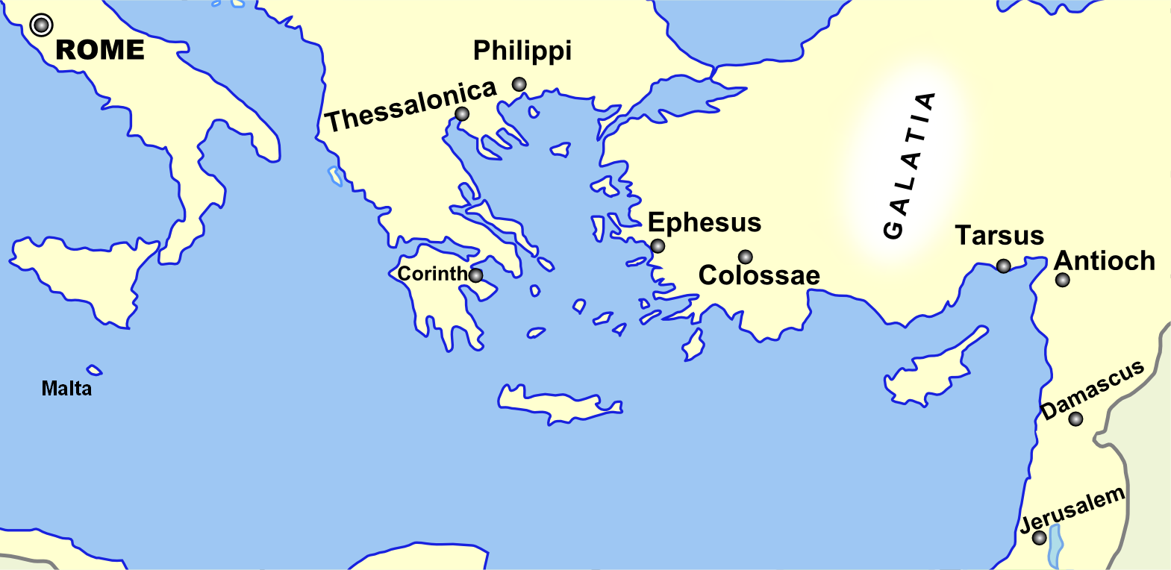
Monozigote. (2012). Broad Overview of Geography Relevant to Paul of Tarsus [Map]. Wikipedia.

Slide 22
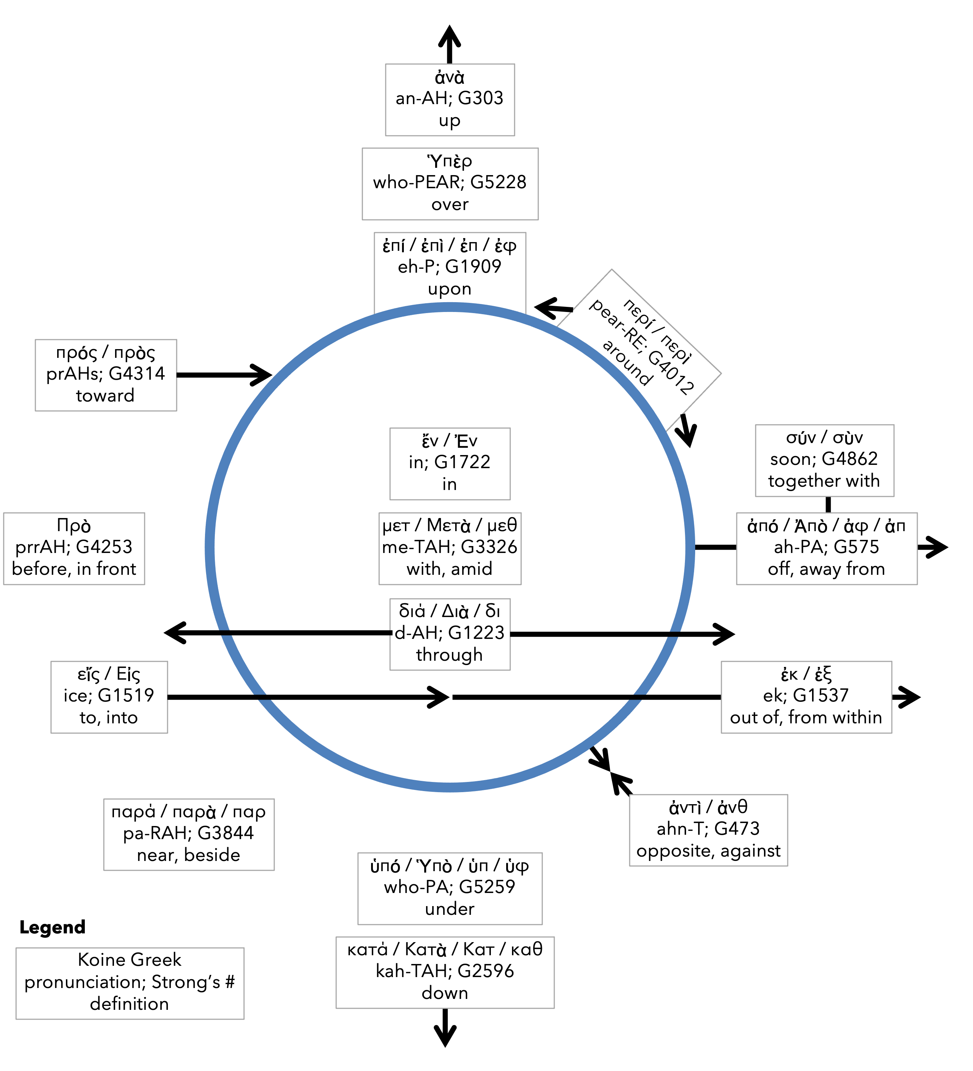
Preposition circle (page 11)

Slide 23
Dr. Gordon Fee …a distinguishable part of the whole, but as part of the whole, not above or outside it

Slide 24
Dr. G. Walter Hansen …a distinguishable part of the whole, but as part of the whole, not above or outside it

Slide 25
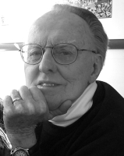
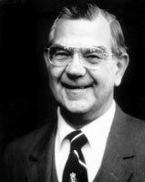
Dr. G. F. Hawthorne & Dr. Ralph P. Martin Paul can see it no other way: as the master was, so must the servant be.

Slide 26
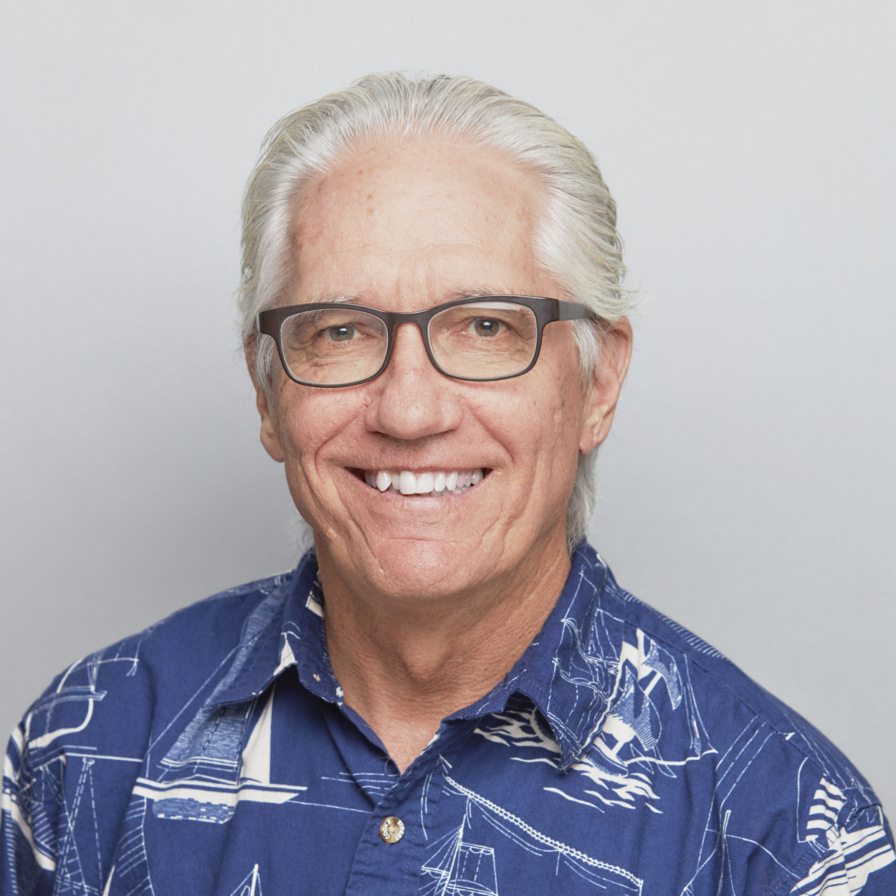
Dr. Joe Hellerman The pacification of the known world by the Romans was known as the pax Romana/ Augusta. The ideology of universal peace and prosperity

Slide 27
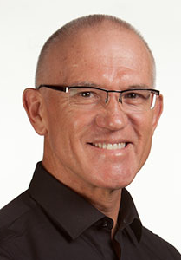
Dr. Mark Keown The pacification of the known world by the Romans was known as the pax Romana/ Augusta. The ideology of universal peace and prosperity under

Slide 28
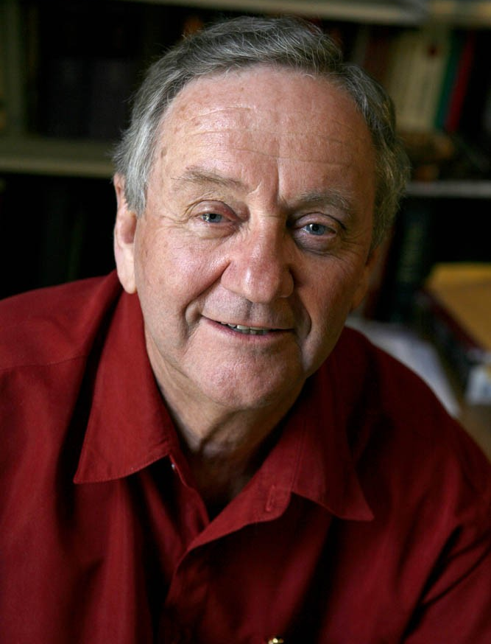
Dr. Peter T. O’Brien The pacification of the known world by the Romans was known as the pax Romana/ Augusta. The ideology of universal peace and prosperity under

Slide 29
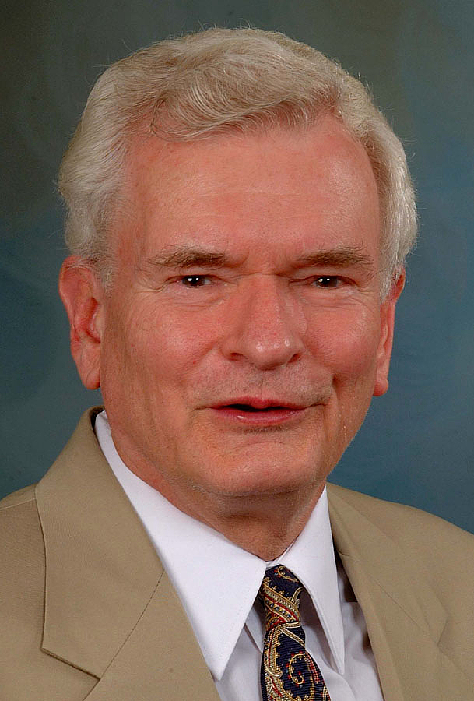
Dr. John Reumann Christ Jesus provides the basis for their relation to God, “glue” for their connections with each other, the sphere for their life and endeavors

Slide 30
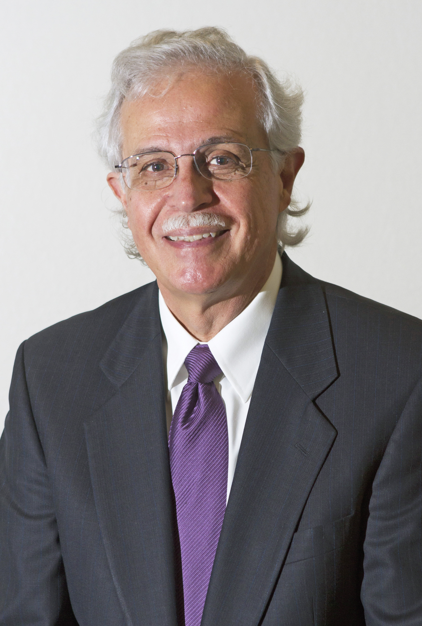
Dr. Moises Silva Christ Jesus provides the basis for their relation to God, “glue” for their connections with each other, the sphere for their life and endeavors

Slide 31
Jen Wilkin The heart cannot love what the mind does not know.

